Slide 1
INTELLIGENT AGENTS
We will discuss
what an intelligent agent does,
how it is related to its environment,
how it is evaluated, and
how we might go about building one.

Slide 2
Introduction
An agent is anything that can be viewed as perceiving its environment through sensors and acting upon that environment through effectors.
A human agent has eyes, ears, and other organs for sensors, and hands, legs, mouth, and other body parts for effectors.
A robotic agent substitutes cameras and infrared range finders for the sensors and various motors for the effectors.

Slide 3
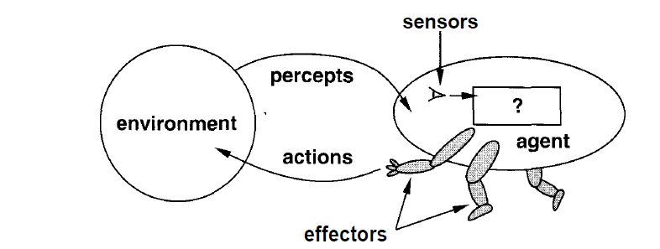

Slide 4
HOW AGENTS SHOULD ACT?
A rational agent is one that does the right thing. Obviously, this is better than doing the wrong thing, but what does it mean?
The right action is the one that will cause the agent to be most successful.
But how to decide and when to evaluate the agent's success?
for the how—the performance measure criteria is used.
There is not one fixed measure suitable for all agents therefore we as outside observers establish a standard of what it means to be successful in an environment and use it to measure the performance of agents.

Slide 5
Example
An agent that is supposed to vacuum a dirty floor
Performance measure :
the amount of dirt cleaned up in a single eight-hour shift
the amount of electricity consumed and the amount of noise generated as well
an agent that not only cleans the floor quietly and efficiently, but also finds time to go windsurfing at the weekend

Slide 6
when to evaluate the performance of agent
Example: we measured how much dirt the agent had cleaned up in the first hour of the day, we would be rewarding those agents that start fast (even if they do little or no work later on), and punishing those that work consistently.
Thus, we want to measure performance over the long run, be it an eight-hour shift or a lifetime

Slide 7
Rationality and omniscience
An omniscient agent knows the actual outcome of its actions, and can act accordingly; but omniscience is impossible in reality.
Example: falling cargo door over a person
Rational at any given time depends on four things:
• The performance measure that defines degree of success.
• Everything that the agent has perceived so far i.e. complete perceptual history or percept sequence.
• What the agent knows about the environment.
• The actions that the agent can perform.

Slide 8
Ideal rational agent
For each possible percept sequence, an ideal rational agent should do whatever action is expected to maximize its performance measure, on the basis of the evidence provided by the percept sequence and whatever built-in knowledge the agent has.

Slide 9
For example, if an agent does not look both ways before crossing a busy road, then its percept sequence will not tell it that there is a large truck approaching at high speed.
According to the definition it would be OK for it to cross the road.
The interpretation is wrong on two counts.
First, it would not be rational to cross the road: the risk of crossing without looking is too great.
Second, an ideal rational agent would have chosen the "looking" action before stepping into the street, because looking helps maximize the expected performance.

Slide 10
The ideal mapping from percept sequences to actions
Once we realize that an agent's behavior depends only on its percept sequence to date, then we can describe any particular agent by making a table of the action it takes in response to each possible percept sequence.
Such a list is called a mapping from percept sequences to actions.
Find out which mapping correctly describes an agent by trying out all possible percept sequences and recording which actions the agent does in response.
Specifying which action an agent ought to take in response to any given percept sequence provides a design for an ideal agent.

Slide 11
Autonomy
For ideal rational agent: If the agent's actions are based completely on built-in knowledge, such that it needs to pay no attention to its percepts, then we say that the agent lacks autonomy (self government).
For example,
If the clock manufacturer was prescient (predictive) enough to know that the clock's owner would be going to Australia at some particular date, then a mechanism could be built in to adjust the hands automatically by six hours at just the right time. This would certainly be successful behavior, but the intelligence seems to belong to the clock's designer rather than to the clock itself.

Slide 12
An agent's behavior can be based on both its own experience and the built-in knowledge used in constructing the agent for the particular environment in which it operates.
It would be reasonable to provide an artificial intelligent agent with some initial knowledge as well as an ability to learn.
An agent that operates on the basis of built-in assumptions will only operate successfully when those assumptions hold, and thus lacks flexibility.
A truly autonomous intelligent agent should be able to operate successfully in a wide variety of environments, given sufficient time to adapt.

Slide 13
STRUCTURE OF INTELLIGENT AGENTS
The job of AI is to design the agent program: a function that implements the agent mapping from percepts to actions.
The program will run on some sort of computing device, which we will call the architecture (computer or special purpose hardware.)
Architecture:
percepts from the sensors available to the program
runs the program
feeds the program's action choices to the effectors as they are generated.
agent = architecture + program

Slide 14
